Slide 1
Data Literacy Graphing and Statisitics

Slide 2
TYPES OF GRAPHS
There are many different graphs that people can use when collecting Data.
Line graphs, Scatter plots, Histograms, Box plots, bar graphs and pie charts.
Some work better to represent data that we collect better than others.

Slide 3
Does it ask if there is a correlation? Are two numbers or factors correlated
If so then you can use a Scatter plot or a Line Graph
Height vs Shoe Size. Scatter plot.
Something changing over time than use a Line Graph.

Slide 4
Scatter plots
Is the Fuel efficiency of a car related to Weight?
Are smoking rates correlated with medium income?
How are temperature and pressure related to a fixed volume?

Slide 5
Line Graphs
Have summer lake water temps increased over the last ten years?
How have the height of humans changes over the past century?

Slide 6
Does your question ask about the variability of a group of data points?
Such as the range of the data , the shape of the distribution, or what is the center of the data. Use Histograms, Dot plots or Box plot
Examples:
Do all high tides rise to the same height?
What is the range and distribution of the incomes in the United States?
How variable are wind speeds in Blaine?

Slide 7
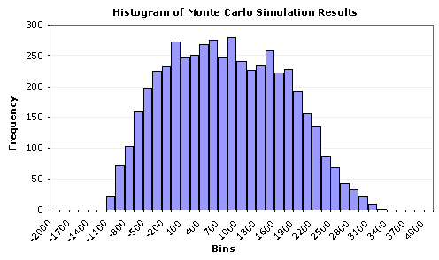
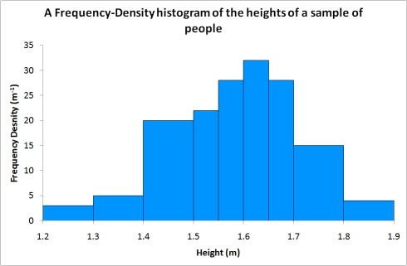
Histograms

Slide 8
Bar Graphs
Use these graphs if you are comparing single numbers.
Such as Median, Mean, or Total.
Was the snowfall greater this year compared to last winter?
How do Median incomes in the U.S. compare to the median incomes in Sweden?

Slide 9
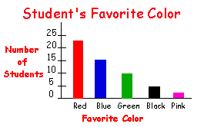
Bar Graphs

Slide 10
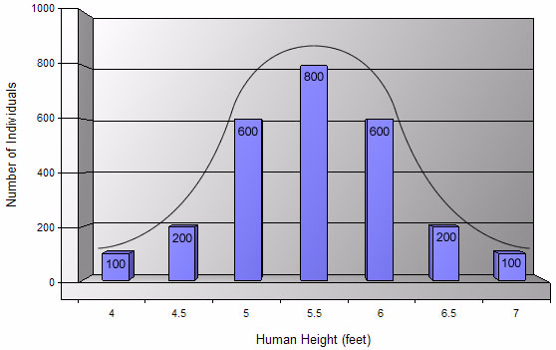
Statistics
Statistical analysis is used to collect a sample size of data which can infer what is occurring in the general population
More practical for most biological studies
Requires math and graphing data
Typical data will show a normal distribution (bell shaped curve).
Range of data

Slide 11
Statistical Analysis
Two important considerations
How much variation do I expect in my data?
What would be the appropriate sample size?

Slide 12
Descriptive statistics is used to estimate important parameters of the sample data set.
measurements of central tendencies such as mean, median, and mode;
and standard error of the mean, which helps you determine your confidence in the sample mean.
Bozeman Science: standard deviation (7’50”) and standard error of the mean (7’05”)

Slide 13
Standard Deviation:
A measure of how spread out the data is from the mean

Slide 14
Measures of Variability
Standard Deviation
In normal distribution, about 68% of values are within one standard deviation of the mean
Often report data in terms of +/- standard deviation
It shows how much variation there is from the "average" (mean).
If data points are close together, the standard deviation with be small
If data points are spread out, the standard deviation will be larger

Slide 15
Lower standard deviation:
Data is closer to the mean
Greater likelihood that the independent variable is causing the changes in the dependent variable
Higher standard deviation:
Data is more spread out from the mean
More likely factors, other than the independent variable, are influencing the dependent variable

Slide 16
σ = standard deviation
68% of data fall within ±1s of mean
95% of data fall within ±2s of mean
99% of data fall within ±3s of mean

Slide 17
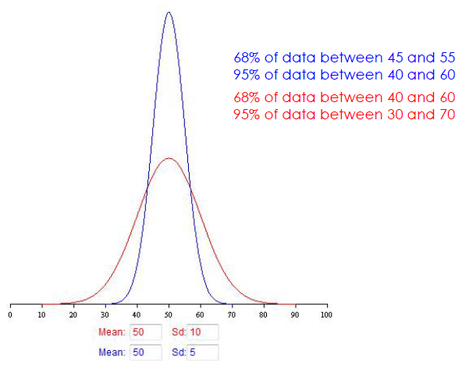
The magnitude of the standard deviation depends on the spread of the data set
Two data sets: same mean; different standard deviation

Slide 18
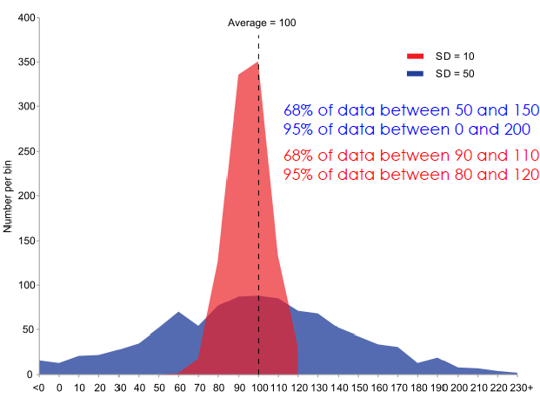
Actual data sets aren’t always so pretty...

Slide 19
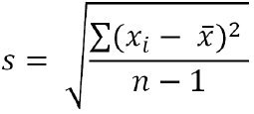
Calculating standard deviation, s
Calculate the mean (x)
Determine the difference between each data point, and the mean
Square the differenes
Sum the squares
Divide by sample size (n) minus 1
Take the square root

Slide 20
http://www.bozemanscience.com/standard-deviation

Slide 21
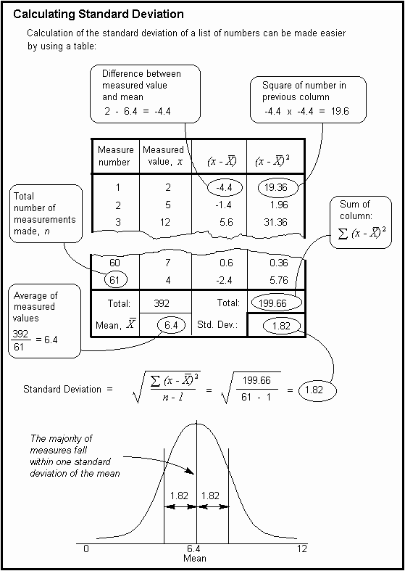
Calculating Standard Deviation

Slide 22
Calculating Standard Deviation
Grades from a quiz
96, 96, 93, 90, 88, 86, 86, 84, 80, 70
1st Step:
find the mean (X)
Measure Number | Measured Value x | (x - X) | (x - X)²
1 | 96 | 9 | 81
2 | 96 | 9 | 81
3 | 92 | 5 | 25
4 | 90 | 3 | 9
5 | 88 | 1 | 1
6 | 86 | -1 | 1
7 | 86 | -1 | 1
8 | 84 | -3 | 9
9 | 80 | -7 | 49
10 | 70 | -17 | 289
TOTAL | 868 | TOTAL | 546
Mean, X | 87 | Std Dev

Slide 23
Calculating Standard Deviation
2nd Step:
determine the deviation from the mean for each grade then square it
Measure Number | Measured Value x | (x - X) | (x - X)²
1 | 96 | 9 | 81
2 | 96 | 9 | 81
3 | 92 | 5 | 25
4 | 90 | 3 | 9
5 | 88 | 1 | 1
6 | 86 | -1 | 1
7 | 86 | -1 | 1
8 | 84 | -3 | 9
9 | 80 | -7 | 49
10 | 70 | -17 | 289
TOTAL | 868 | TOTAL | 546
Mean, X | 87 | Std Dev

Slide 24
Calculating Standard Deviation
Measure Number | Measured Value x | (x - X) | (x - X)²
1 | 96 | 9 | 81
2 | 96 | 9 | 81
3 | 92 | 5 | 25
4 | 90 | 3 | 9
5 | 88 | 1 | 1
6 | 86 | -1 | 1
7 | 86 | -1 | 1
8 | 84 | -3 | 9
9 | 80 | -7 | 49
10 | 70 | -17 | 289
TOTAL | 868 | TOTAL | 546
Mean, X | 87 | Std Dev
Step 3:
Calculate degrees of freedom (n-1)
where n = number of data values
So, 10 – 1 = 9

Slide 25
Calculating Standard Deviation
Measure Number | Measured Value x | (x - X) | (x - X)²
1 | 96 | 9 | 81
2 | 96 | 9 | 81
3 | 92 | 5 | 25
4 | 90 | 3 | 9
5 | 88 | 1 | 1
6 | 86 | -1 | 1
7 | 86 | -1 | 1
8 | 84 | -3 | 9
9 | 80 | -7 | 49
10 | 70 | -17 | 289
TOTAL | 868 | TOTAL | 546
Mean, X | 87 | Std Dev | 8
Step 4:
Put it all together to calculate S
S = √(546/9)
= 7.79
= 8

Slide 26
Standard Error:
Indication of how well the mean of a sample (x) estimates the true mean of a population (μ)
Measure of accuracy, if the true mean is known
Measure of precision, if true mean is not known

Slide 27
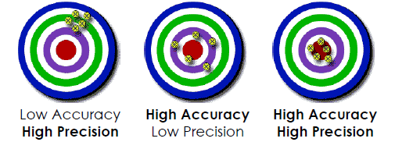
Accuracy – How close a measured value is to the actual (true) value
Precision – How close the measured values are to each other.

Slide 28
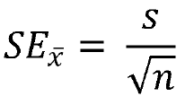
Calculating Standard Error, SE
Calculate standard deviation
Divide standard deviation by square root of sample size

Slide 29
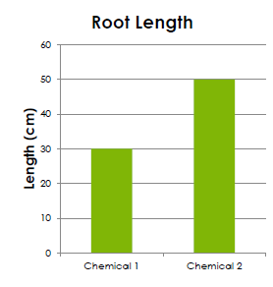
How do we use Standard Error?
Create bar graph
mean on Y-axis
sample(s) on the X-axis
chemical 1 mean = 30 cm
chemical 2 mean = 50 cm

Slide 30
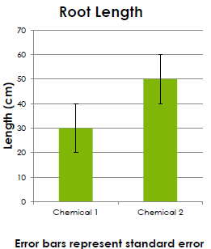
Add error bars!
± SE
Indicate in figure caption that error bars represent standard error (SE)

Slide 31
Analyze!
Look for overlap of error lines:
If they overlap: The difference is not significant
If they don’t overlap: The difference may be significant

Slide 32
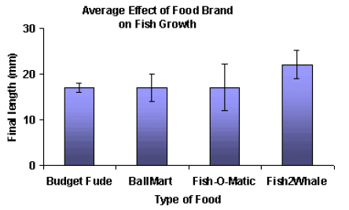
Which is a valid statement?
Fish2Whale food caused the most fish growth
Fish2Whale food caused more fish growth than did Budget Fude
✗
✓

Slide 33
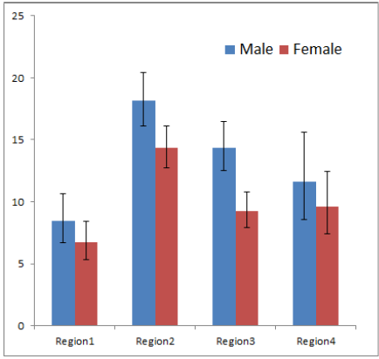
Statements:
In all four regions, more males exhibited the trait measured than did females.
More males in region 3 exhibited the measured trait than did females
✗
✓

Slide 34
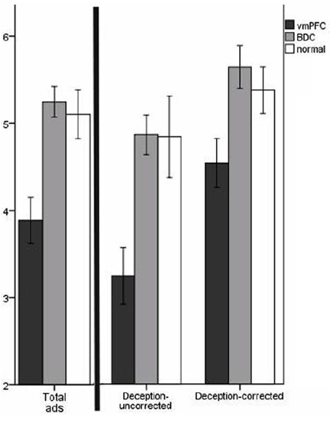
Mean belief scores for misleading ads
vmPFC = damage to ventromedial prefrontal cortex
BDC = brain damaged comparison group
Statements:
The vmPFC group identified fewer ads as misleading than did the normal group
The BDC group identified more ads as misleading than did the normal group.
# of ads identified as misleading
✓
✗

Slide 35
Calculating Standard Error
So for the class data:
Mean = 87
Standard deviation (S) = 8
1 s.d. would be (87 – 8) thru (87 + 8) or 81-95
So, 68.3% of the data should fall between 81 and 95
2 s.d. would be (87 – 16) thru (87 + 16) or 71-103
So, 95.4% of the data should fall between 71 and 103
3 s.d. would be (87 – 24) thru (87 + 24) or 63-111
So, 99.7% of the data should fall between 63 and 111

Slide 36
Measures of Variability
Standard Error of the Mean (SEM)
Accounts for both sample size and variability
Used to represent uncertainty in an estimate of a mean
As SE grows smaller, the likelihood that the sample mean is an accurate estimate of the population mean increases

Slide 37
http://www.bozemanscience.com/standard-error

Slide 38
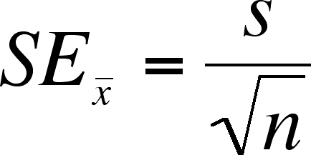
Calculating Standard Error
Using the same data from our Standard Deviation calculation:
Mean = 87
S = 8
n = 10
SE_{X} = 8/ √10
= 2.52
= 2.5
This means the measurements vary by ± 2.5 from the mean
Bozeman video: Standard Error

Slide 39
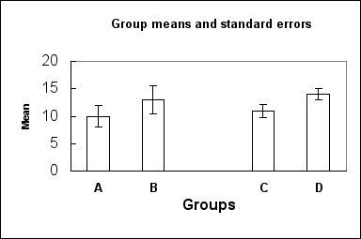
Graphing Standard Error
Common practice to add standard error bars to graphs, marking one standard error above & below the sample mean (see figure below). These give an impression of the precision of estimation of the mean, in each sample.
Which sample mean is a better estimate of its population mean, B or C?
Identify the two populations that are most likely to have statistically significant differences?

Slide 40
Consider these 3 plant populations:
When two SEM error bars don't overlap at all (like Pop. 1 and Pop. 3), and they are representing +/- 2 SEM, then you can be 95% confident there is a significant difference between the two populations (you can do other statistical tests to affirm this). (You can say, “the difference between Pop. 1 and Pop. 3 is significant at p<0.05”.)
When the +/- 2 SEM error bars do overlap but don't overlap the mean then you don't really know without a test--it might be or might not be a significant difference. Comparing Pop. 2 and Pop. 3 is this type of situation.
Finally, if the error bars overlap and that overlap includes the means, then you can be fairly confident there is no real difference. This is the situation comparing Pop. 1 and Pop 2.

Slide 41
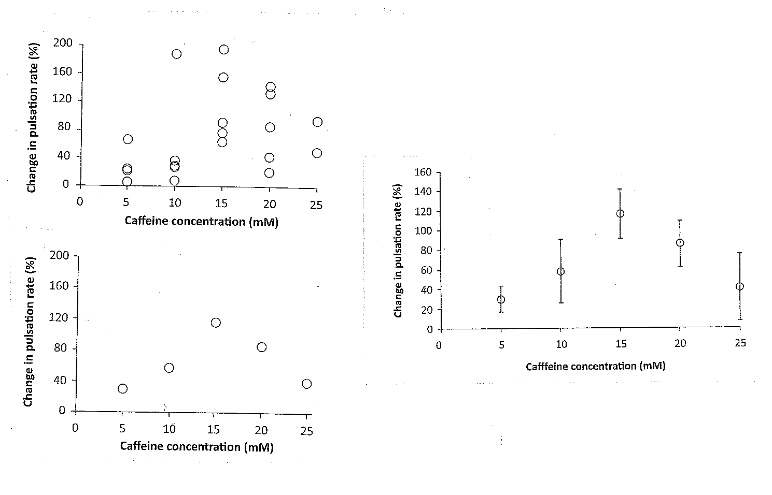
Little overlap, likely to be significantly different
So much overlap, may not be significantly different

Slide 42
